Slide 1

SLAP INNOVATORS
Audio-Feedback Based Parking Assist System

Slide 2
Problem Statement
Problem : Lack of blind spot coverage in most modern and older cars
Solution : Audio-Feedback based parking assist system

Slide 3
Justification
Market survey results show that the problem exists

Slide 4
Justification
Survey also shows that investors are willing to invest in our product

Slide 5
Task Allocation
Sithum – Designing Enclosure, Marketing
Lahiru – Designing Enclosure, Overseeing Budget
Amoda – Designing PCB, Power Supply
Pravindu – Sensors, Buzzers, and Microcontrollers

Slide 6
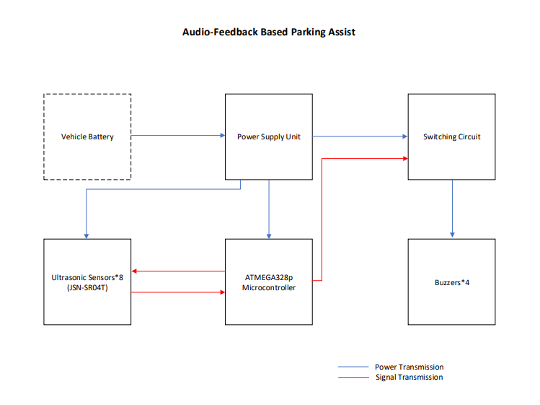
Block Diagram

Slide 7
Power Supply
Directly from brake lights
Maximum power consumption : (3W) 5V/0.6A

Slide 8
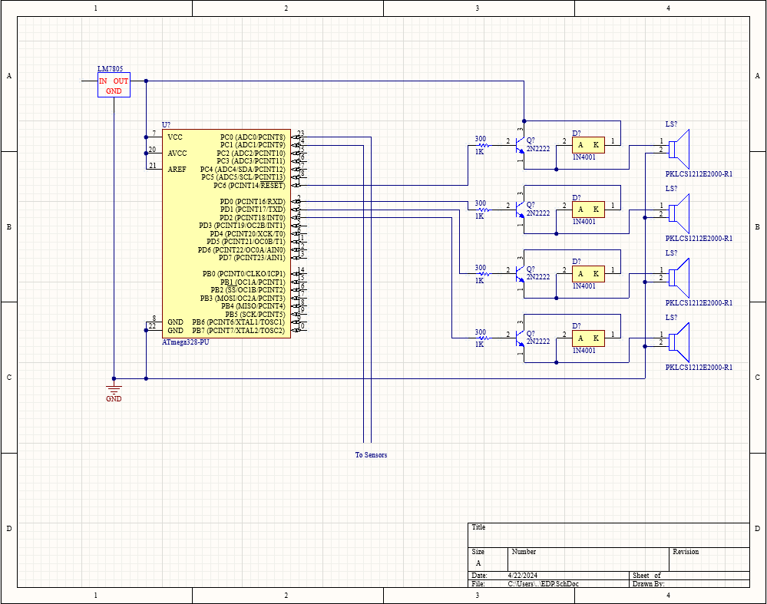
PCB

Slide 9
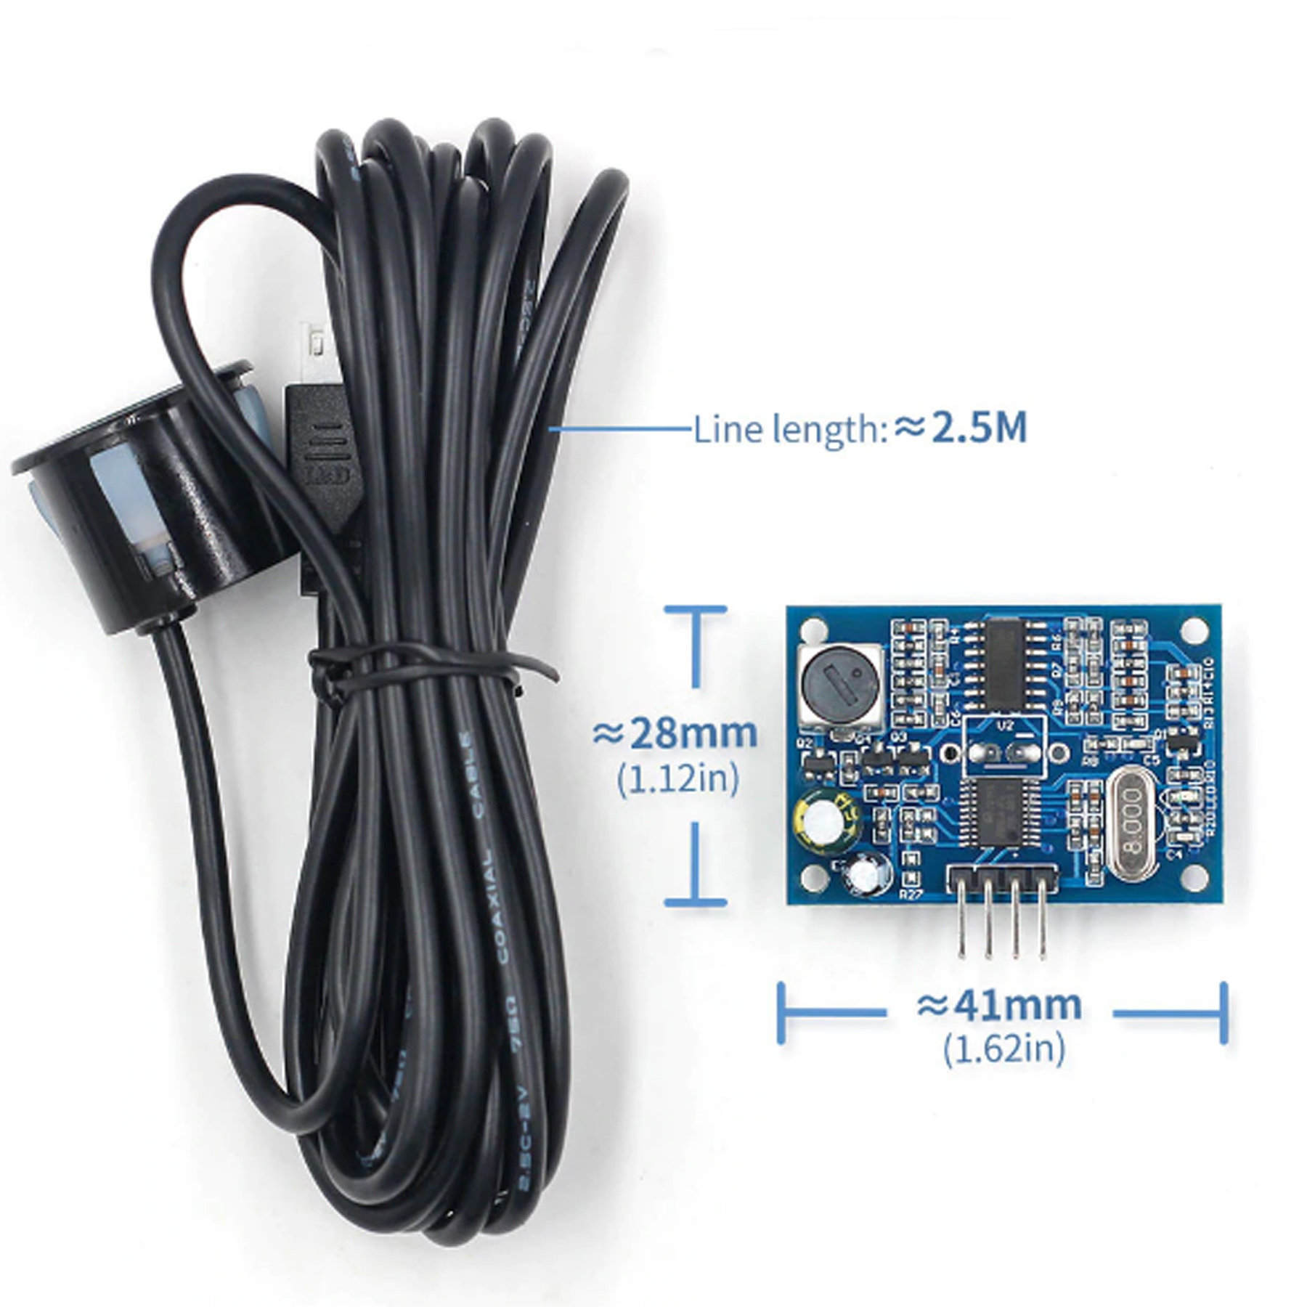
Sensor
Sensor : JSN-SR04T
Initial testing conducted
Capabilities and restraints identified
Measurements accurate to a couple of cm
Waterproof
Will be attached to vehicles by drilling holes in the bumper

Slide 10
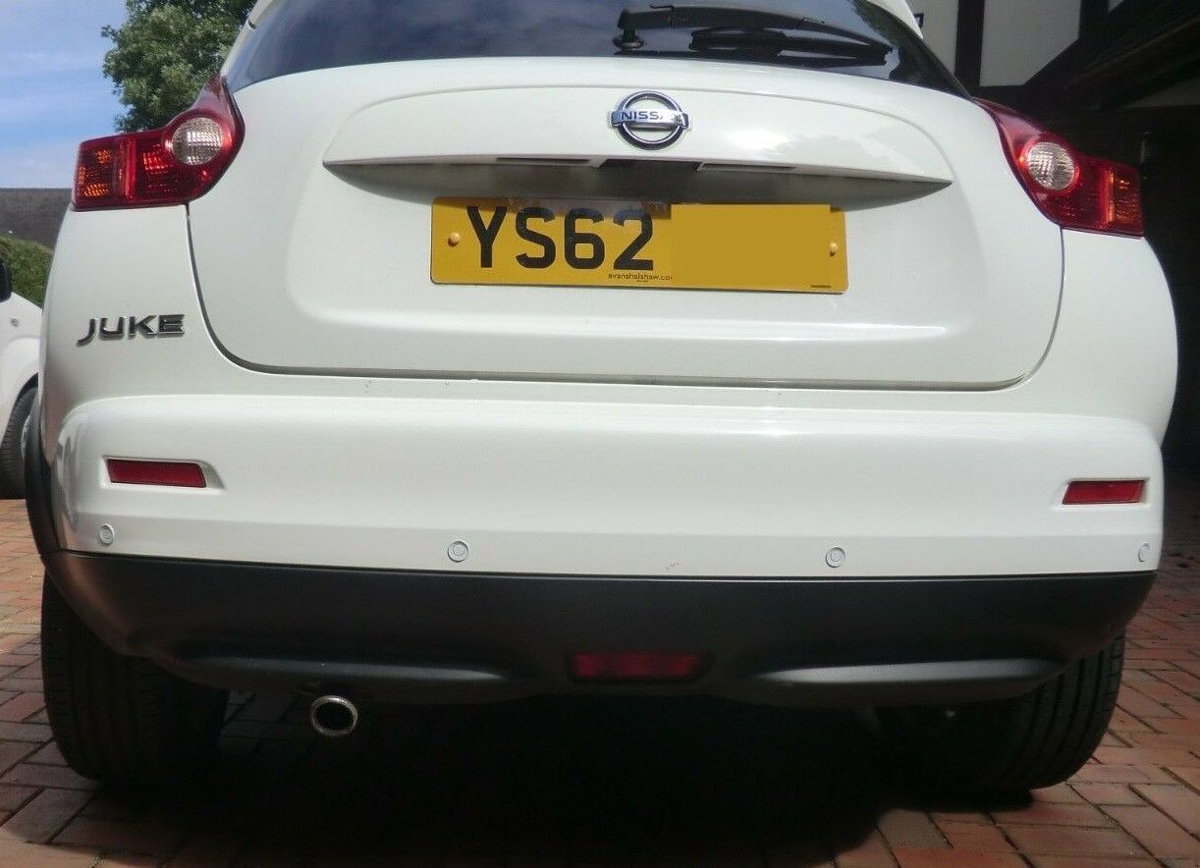
Mounting

Slide 11
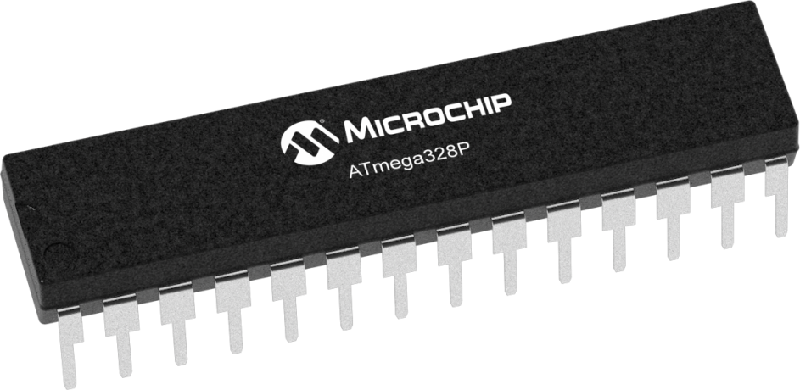
Microcontroller
Microcontroller : ATMEGA328p
Low cost
Low power consumption
Sufficient i/o ports

Slide 12
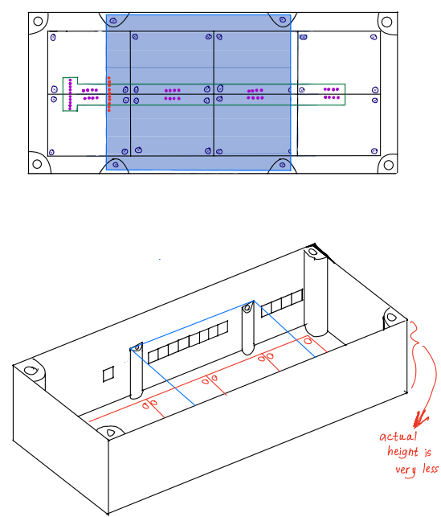
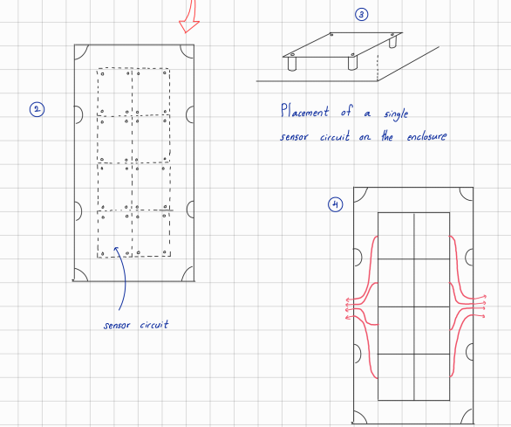
Enclosure : Initial Design

Slide 13
Budget/BOQ
No. | Item | Qty | Rate (Without Shipping) | Total Cost
1 | JSN_SR04T | 8 | 542 | 4336
2 | ATMEGA328 | 1 | 750 | 750
3 | PCB | 2 | 250 | 500
4 | Enclosure | 1 | 2500 | 2500
5 | Buzzers | 4 | 400 | 1600
6 | Voltage Regulator | 1 | 70 | 70
 | TOTAL |  |  | 9756

Slide 14

Technical Feasibility
Resource requirements can be met within budget
Bulk pricing and low-cost equipment
Performance criteria
Sensors are accurate to within 1cm
Sensor range from 20 cm – 450 cm
Buzzers loud enough to be heard from all ends
Testing the sensor sensitivity

Slide 15

Marketing and Sales Strategy
Packaging : Matte plastic. Colors TBD.
Through direct sales and partnerships with vehicle service stations, vehicle accessory shops etc.
Marketing through ads on social media platforms.
Will be made of reusable materials. Discount on next purchase for in exchange for used items older than 7 years.
Post Sale Services
Repair and troubleshooting
3 years warranty

Slide 16

Thank You
SLAP Innovators

